Slide 1
Mobile Computing
By Madiha Hameed

Slide 2
How to Launch your Application
There are few steps to follow for a better launch to you application
1) Know your application
2) Choose unique name for your application
3) Find your competitors
4) Choose the right category for your application
5) Creating an attractive application logo
6) Screen Shots.
7) Application Demo Video
8) Landing Page
9) Press Release Buzz

Slide 3

Know your application
Collect a list of successful application
Check out how they are profited by name , design ,icon

Slide 4
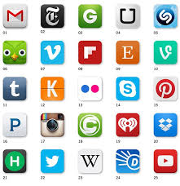
Choose unique name for your application
Unique
Memorable
Include most important key word
Don’t infringe any trade mark

Slide 5
Find your competitors
Observe other developers work

Slide 6
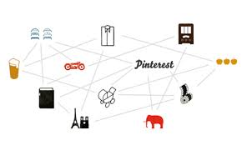
Choose the right category for your application
Estimate the number of download you need to rank your application
Calculate the strength:
The more competitors The more downloads you get

Slide 7

Creating an attractive application logo
Icon matter a lot
Make it eye catching and amazing
Deliver style and purpose

Slide 8
Screen Shots.

Slide 9

Application Demo Video
Explain What the application do
Make them memorable ,informative and exciting
Convince viewers to buy /download the application

Slide 10
Landing Page
Write good Title ,description and Keyword
Showcase your App’s finest feature
Include screen shots and demo videos

Slide 11
Press Release Buzz
Review the sites
Start collecting data well held your launch
Contact every once apps goes live

